Slide 1
Mixed Reality Workshop
Speaker name

Slide 2
Agenda
👋 Welcome & Introductions
📺 Introduction to the Power Platform
📺 Introduction to Power Apps & Canvas Apps
👩🏾‍💻 Lab 1: Creator Kit and Canvas Apps
👩🏾‍💻 Lab 2: View MR in Canvas Apps
📺 Introduction to Custom Connectors
👩🏾‍💻 Lab 3: Create your first Custom Connector
👩🏾‍💻 Lab 4: View in 3D in Canvas Apps

Slide 3
👋 Welcome & Introductions

Slide 4
Speaker name
Speaker details

Slide 5
👋 Welcome & Introductions
What is your name?
What is your role?
What are your expectations of this workshop?

Slide 6
📺 Introduction to the Power Platform

Slide 7

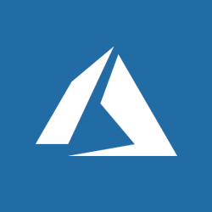






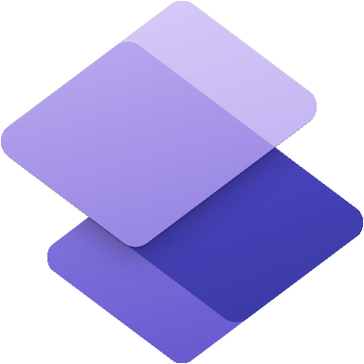

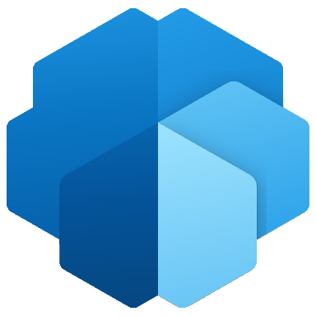
Microsoft Power Platform
Microsoft Power Platform
One low-code platform that spans Office 365, Dynamics 365, Azure and standalone applications
Dynamics 365
Office 365
Azure
Your business apps & data
Power BI
Business analytics
Power Apps
Application development
Power Automate
Workflow automation
Power Virtual Agents
Intelligent virtual agents
Power Pages
Build websites
Dataverse
Data connectors
AI Builder
Notes:
Microsoft Power Platform is bigger than the sum of its parts. PowerApps, along with Power BI and Flow, makes up Microsoft Power Platform. This is an end-to-end platform for low-code and rapid development, for Office 365, Dynamics 365, Azure or your own custom app development or customization.
Dataverse, Data Connectors, and new AI Builder also are common building blocks across Microsoft Power Platform.
Dataverse is about connecting business data in a well-structured form that facilitates reasoning over it - But it’s not just your business application data
Productivity and Collaboration data from Office 365, including email, calendars, phone calls, messaging
Professional networks – LinkedIn for contacts, connections, skills, employment history
Other solutions and External data, such as our partnership with Adobe, we are now able to add the marketing data to our business graph, lighting up business processes to deliver truly personalized customer experiences

Slide 8
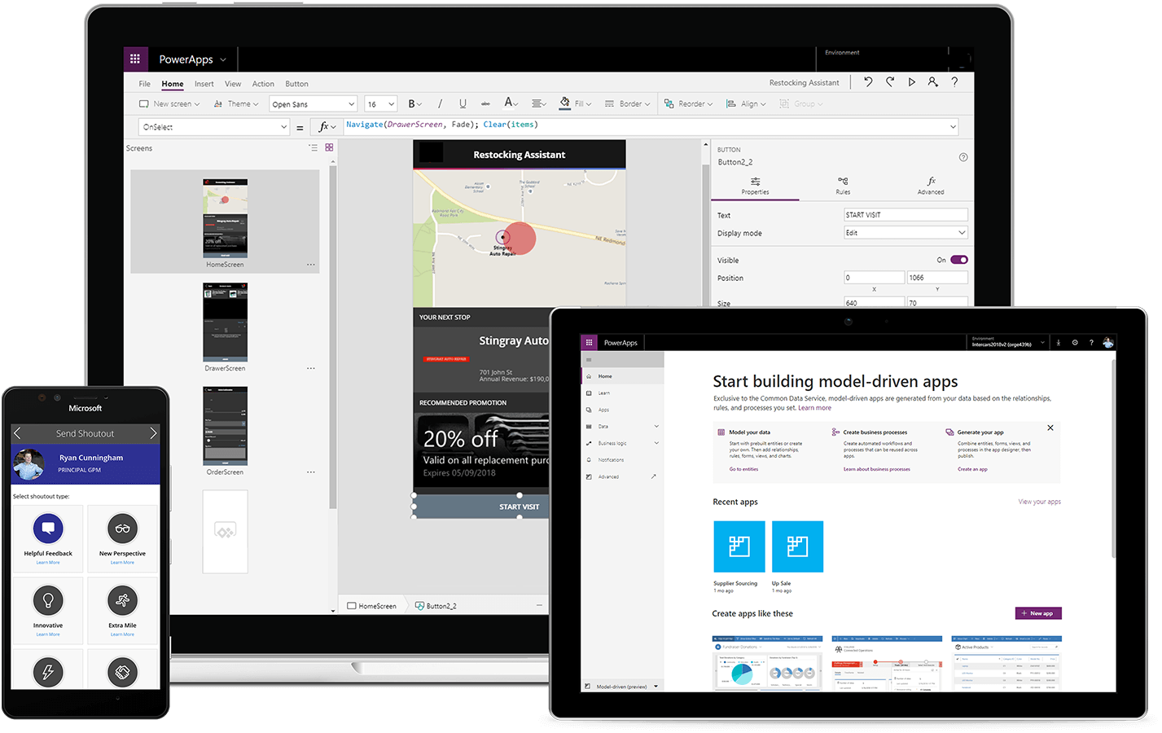
Power Platform: the world’s most complete low-code platform
Build business apps faster, easier
Empower everyone to create impactful business solutions in hours - not months – with familiar tools.
Take your apps to the next level
Enable citizen developers to work directly with pro developers for even more advanced solutions.
Scale with confidence
Build solutions at scale while maintaining governance, security and quality standards.
One platform, unlimited innovation
Shift your low-code apps into high gear continuously with advanced AI, analytics, bots, interactive maps, external portals, mixed reality, IoT and more.

Slide 9
Build business apps faster, easier Empower everyone to build apps in hours—not months—with familiar Microsoft tools
Get started quickly
Build and launch apps right away using pre-built templates and drag-and-drop simplicity. Launch apps with one click and deploy across iOS, Android, Windows, and Web
Build the right app for the job
Optimize for specific tasks and roles. Or start from a common business scenario template. Build for any device and leverage controls like cameras and location
Automate business processes
Build time-saving workflows into everything from individual tasks to large-scale systems and put intelligent solutions to work with built-in AI capabilities
Build business apps faster, easier
Take your apps to the next level
Scale with confidence
One platform, unlimited innovation
Notes:
Enable everyone to turn ideas into apps. With PowerApps, everyone, no matter their skillset, can add business value by quickly and securely developing innovative apps to reduce inefficiencies and solve business challenges.
Automate paper processes and manual data collection. Streamline task and role-specific scenarios like inspections, field sales enablement, prospect-to-cash and integrated marketing views.
Get even more out of your Microsoft investments. Power Apps is natively integrated with the world’s largest cloud ecosystem - Office 365, Dynamics 365 and Azure – so you can do more with the tools you use.
Do more with your business data. Unify data across all your business processes to create apps and workflows that move data more efficiently across departments and divisions.
Collaborate to create even better apps. Business users can immediately start to solve precise business problems, while partnering with professional developers to incorporate advanced functionality.
Develop more efficiently. The average cost to develop an app is 70% less with Power Apps than with traditional coding methods.

Slide 10
Take your apps to the next level Enable citizen developers to work directly with pro developers for more advanced solutions
Build with, not for, business
Bring business and IT build together on the same platform so users can contribute directly to apps, input requirements in real time, and fine tune to meet changing needs
Tailor with custom components
Empower your pro devs to add custom code to your low code projects to extend capabilities and create reusable components for use by pro and citizen developers
Ramp up for 1000s of apps
Leverage powerful build tools to automate processes and testing for perfect, low-code apps – whether your organizations plans to build one or one thousand
Build business apps faster, easier
Take your apps to the next level
Scale with confidence
One platform, unlimited innovation
Notes:
Ensure quality with PowerApps checker. We’ve recently announced the general availability of solution checker – a powerful analysis tool that identifies potential performance and stability risks across all the assets in a solution, directing developers to specific guidance on how to improve. Customers leveraging the PowerApps checker in preview saw significant performance improvement in key scenarios like form load time when they resolved issues identified by the checker.
Enable extensibility for your developers. Provide professional developers the tools to seamlessly extend app capabilities and link your apps to proprietary or on-premises systems.
Empower your pro developers to do more. Enable your professional developers to add advanced functionality to your apps and use the same platform to build complex mission critical apps and modernize legacy apps.
Specialist not required. No need to hire hard-to-find developers on specialized platforms. Power Apps work with the world’s most popular developer tools.
Snap in custom components. Professional developers can quickly create reusable custom APIs and UI components and share out to citizen developers.
Accelerate delivery of 1000s of apps without compromising quality. Power Apps build tools enable developers to automate build processes and testing to build perfect, low-code apps faster than ever before.
Automate business processes. Build time-saving workflows into everything from individual tasks to large-scale systems and put intelligent workflows to work with built-in AI capabilities.
Extend and integrate Azure services. If you have existing Azure services, you can easily extend Bot Services, Logic Apps, Functions, Cognitive Services, Synapse, and more with clicks, not code.
Get solutions tailored to your industry. Industry solution accelerators enable you, your partners and other solution providers to quickly build industry vertical solutions.

Slide 11
Scale with confidence Drive innovation at scale while maintaining governance, security and quality
Quality control
A full view of your apps, usage and creators eliminates Shadow IT. Maintain standards and drive best practices with the Center of Excellence toolkit
No compromise protection
Built-in capabilities enable you to control who can access which apps and data using built-in identity protection and DLP policies. Meet compliance with more than 90 certifications
Enterprise-grade performance
Built on Azure with massive scale, 100+ data centers worldwide and a 99.9% financially backed uptime guarantee
Build business apps faster, easier
Take your apps to the next level
Scale with confidence
One platform, unlimited innovation
Notes:
Centralize management of your apps. Manage all aspects of app development—users, apps, usage, and settings—in a single admin experience to maintain app standards and reduce the risk of shadow IT.
Quickly establish best practices. The Microsoft Power Platform Starter Kit is a collection of components and tools that are designed to help you maintain Power App standards, consistency, and governance. Re-use IP for consistency. Enable your pro developers to build and share UI components to eliminate duplication and inefficiencies, lower maintenance, and create a consistent look and feel for apps across your organization.
Go with a platform you can trust. Get enterprise reliability via 100+ Azure data centers, Microsoft’s global network edge and a 99.9% financially backed uptime guarantee.
Meet your compliance needs. Power Apps has over 90 compliance certifications, more then any other low code data platform, including ISO 27001, FedRamp, and EU model clauses.
Control your data flow. Benefit from built-in information protection and usage analytics with full audit logs, data loss prevention policies and more.
Run with an industry leader. Power Apps has been ranked as a leading low-code platform by both Gartner and Forrester.

Slide 12
One platform, unlimited innovation Solve your business problems quickly with a comprehensive set of boundary pushing capabilities.
Leverage artificial intelligence
Outpace competitors by infusing your process automation with AI. Or easily build your own AI models for solutions like image classification and language translation.
Snap in advanced automation
Leverage pre-built components to automate services and business processes. Link apps to the real world through interactive maps and mixed reality. Develop IoT solutions for operational efficiencies.
Share data externally
Create no-code websites with Power Apps Portals to allow anyone inside or outside your organization to sign in, create and view data securely, or browse content anonymously.
Build business apps faster, easier
Take your apps to the next level
Scale with confidence
One platform, unlimited innovation
Notes:
Simplify tasks with intuitive AI. Get straight to productivity with pre-built AI scenarios like text recognition (OCR). Or easily build, train, and publish your own AI models for solutions like image classification and language translation.
Create powerful chatbots. Solve common customer and internal-facing issues automatically by designing chatbots using a guided, no-code graphical interface.
Streamline business process automation with RPA. Save time and effort with UI flows, a robotic process automation (RPA) capability. Automate mundane, rules-based tasks with point-and-click simplicity—whether the app is old or new, on-premises or in the cloud.
Integrate interactive map capabilities. New geospatial features make it easy to integrate location-based capabilities, add interactive maps, map current location of user, get dynamic address suggestions as you type and more.
Add mixed reality experiences. Blend the physical word with the digital world using drag-and-drop components to communicate better with 3D models, check physical spaces against technical requirements, take measurements directly through an app, and more.
Develop low-code IoT solutions. Use Azure to intake, process, analyze and store IoT data, then visualize it in a Power App solution to provide instant insights into data.
Provide secure, external access to data. Create no-code, responsive websites with Power Apps portals to allow anyone inside or outside your organization to sign in, create and view data securely, or browse content anonymously.

Slide 13
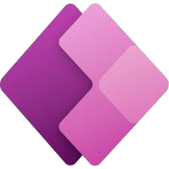
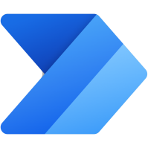

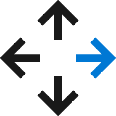
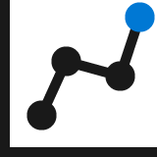
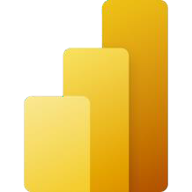

Power Platform: Everyone’s platform for transformation
Power Apps
Drive business processes
Improve engagements with customers and employees
No Code
Drag and drop experiences that are like PowerPoint
Power Automate
Power Virtual Agents
Low Code
Drag and drop plus Excel-like formulas for functionality
Automate response metrics
Analyze data from apps and bots
Power BI
Code First
Professional development and extensibility across Microsoft
AI Builder
Dataverse
Data Connectors
Management Tools
Notes:
Power Platform is a unified platform of low-code tools that spans Office 365, Azure, Dynamics 365, and standalone applications helps you analyze data, build solutions, automate processes, and create virtual agents to transform your business. Power Platform is a rapid application development platform that enables citizen developers with limited coding abilities to innovate and build new solutions faster in an environment and user experience that feels like PowerPoint and Excel.
Additionally, Power Platform is a rapid application development and extensibility framework for professional developers. For the professional developer, Power Platform is the rapid application development platform and extensibility platform of choice because it seamlessly integrates the high-speed capabilities of low-code tools and prebuilt components with no-cliffs extensibility across Azure and other professional development environments.
Power Platform is a transformative solution because it enables all kinds of developers and employees to collaborate and build solutions – whether no code, low code, or code first.

Slide 14
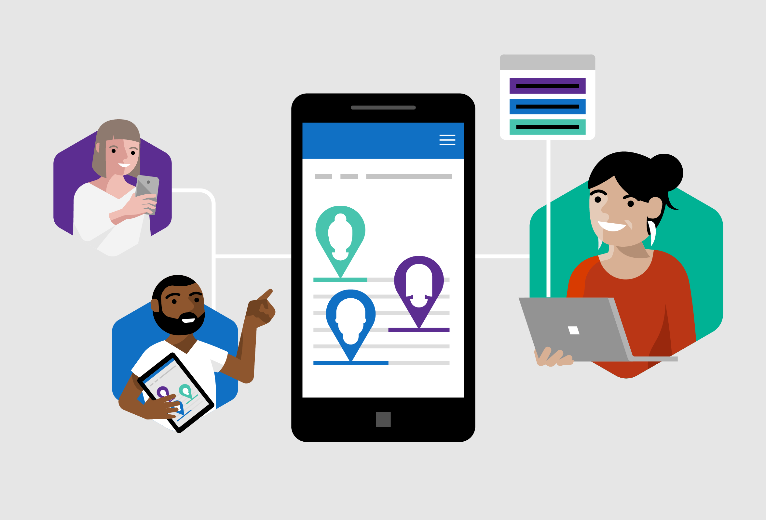
Empower developers to do more
Empower every developer to do more
Citizen Developers
IT Developers
Pro Developers
Notes:
focus on how Power Apps is for everyone

Slide 15
Microsoft Power Platform
Microsoft Power Platform
One low-code platform that spans Office 365, Dynamics 365, Azure and standalone applications
Dynamics 365
Office 365
Azure
Your business apps & data
Power BI
Business analytics
Power Apps
Application development
Power Automate
Workflow automation
Power Virtual Agents
Intelligent virtual agents
Power Pages
Build websites
Dataverse
Data connectors
AI Builder
Notes:
Microsoft Power Platform is bigger than the sum of its parts. PowerApps, along with Power BI and Flow, makes up Microsoft Power Platform. This is an end-to-end platform for low-code and rapid development, for Office 365, Dynamics 365, Azure or your own custom app development or customization.
Dataverse, Data Connectors, and new AI Builder also are common building blocks across Microsoft Power Platform.
Dataverse is about connecting business data in a well-structured form that facilitates reasoning over it - But it’s not just your business application data
Productivity and Collaboration data from Office 365, including email, calendars, phone calls, messaging
Professional networks – LinkedIn for contacts, connections, skills, employment history
Other solutions and External data, such as our partnership with Adobe, we are now able to add the marketing data to our business graph, lighting up business processes to deliver truly personalized customer experiences

Slide 16
📺 Introduction to Power Apps & Canvas Apps

Slide 17
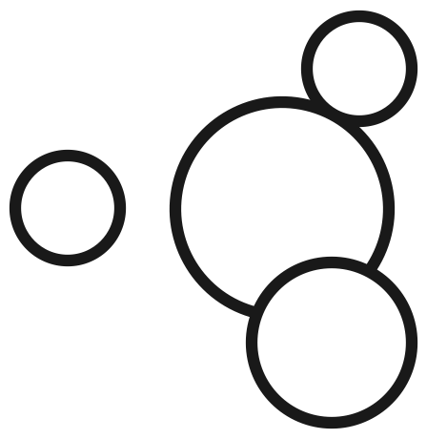
Microsoft Power Platform
Microsoft Power Platform
One low-code platform that spans Office 365, Dynamics 365, Azure and standalone applications
Dynamics 365
Office 365
Azure
Your business apps & data
Power BI
Business analytics
Power Apps
Application development
Power Automate
Workflow automation
Power Virtual Agents
Intelligent virtual agents
Power Pages
Build websites
Dataverse
Data connectors
AI Builder
Notes:
Microsoft Power Platform is bigger than the sum of its parts. PowerApps, along with Power BI and Flow, makes up Microsoft Power Platform. This is an end-to-end platform for low-code and rapid development, for Office 365, Dynamics 365, Azure or your own custom app development or customization.
Dataverse, Data Connectors, and new AI Builder also are common building blocks across Microsoft Power Platform.
Dataverse is about connecting business data in a well-structured form that facilitates reasoning over it - But it’s not just your business application data
Productivity and Collaboration data from Office 365, including email, calendars, phone calls, messaging
Professional networks – LinkedIn for contacts, connections, skills, employment history
Other solutions and External data, such as our partnership with Adobe, we are now able to add the marketing data to our business graph, lighting up business processes to deliver truly personalized customer experiences

Slide 18

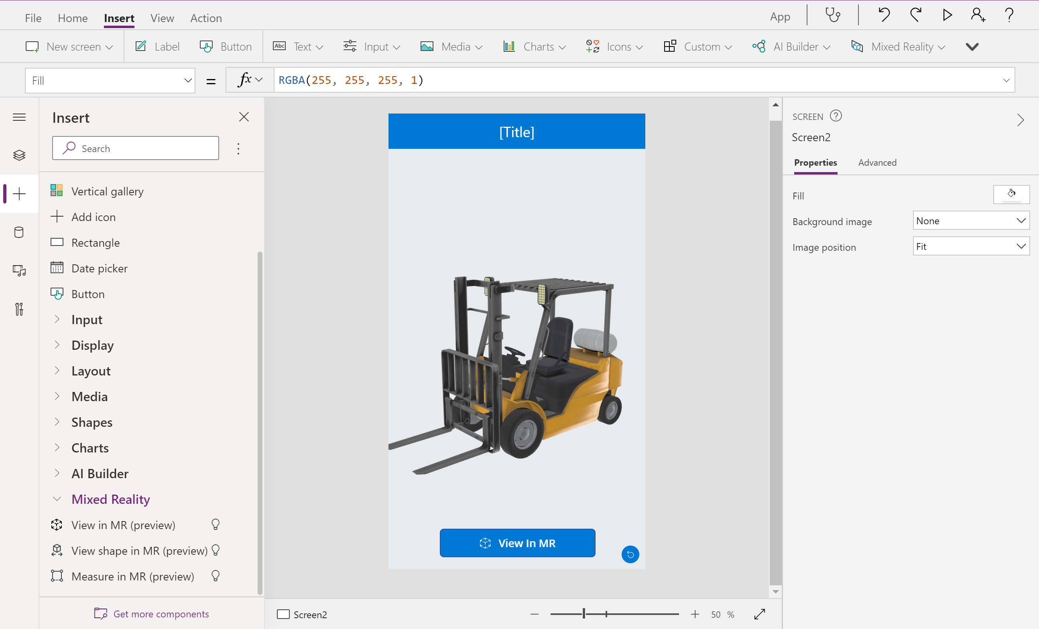
Mixed Reality Components
MR Controls
View in MR
View shape in MR
Measure in MR
Markup in MR
3D Controls
View in 3D

Slide 19
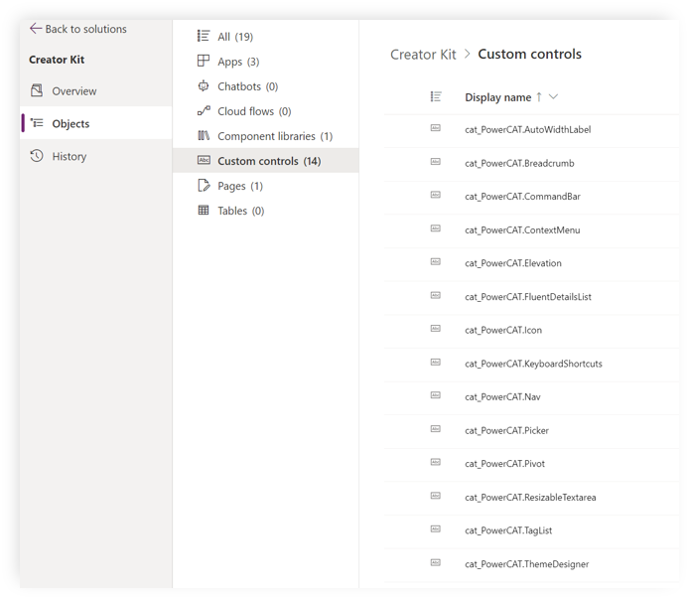
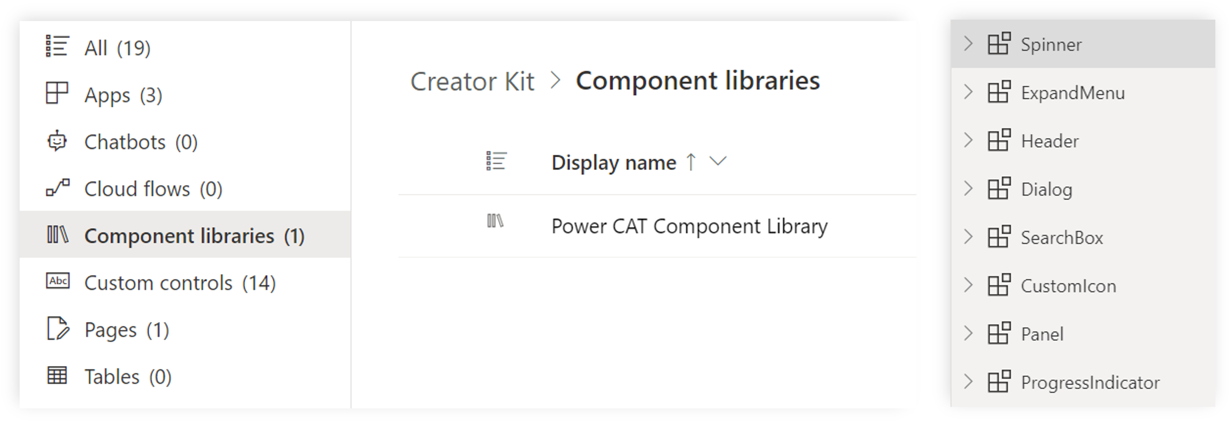
Creator Kit
Set of components for Power Apps
Canvas Components
Code Components

Slide 20
👩🏾‍💻 Lab 1: Creator Kit and Canvas Apps

Slide 21
Lab 1 Objectives
Learn about solutions
Learn how to setup a solution
Learn how to import a solution
Learn how to create a Canvas App
Link to lab: https://aka.ms/mr-workshop-lab1

Slide 22
👩🏾‍💻 Lab 2: Use MR in Canvas Apps

Slide 23
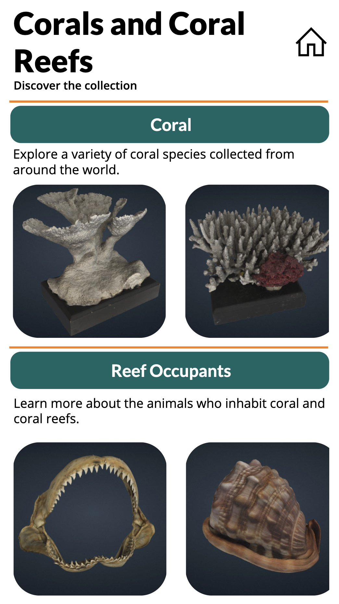
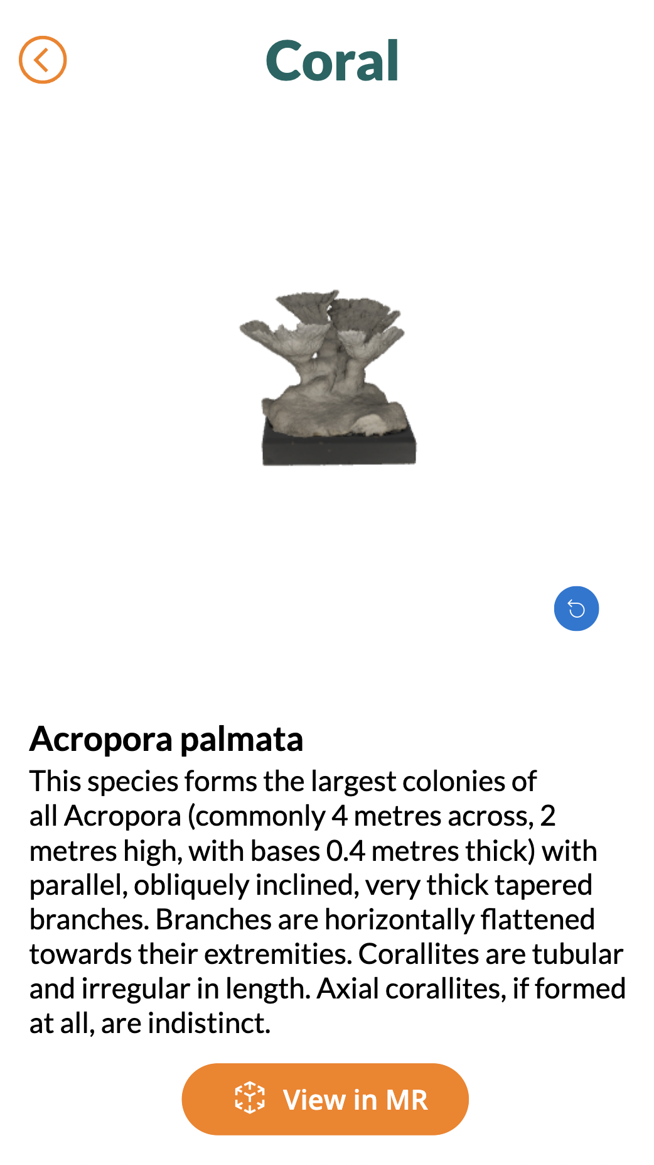
Lab 2 Objectives
Learn how to connect a Custom Connector to a Canvas App
Learn about filtering a data source
Link to lab: https://aka.ms/mr-workshop-lab2

Slide 24
Lab 2 Presentation
Who would like to show his / her result?

Slide 25
📺 Introduction to Custom Connectors

Slide 26
Microsoft Power Platform
Microsoft Power Platform
One low-code platform that spans Office 365, Dynamics 365, Azure and standalone applications
Dynamics 365
Office 365
Azure
Your business apps & data
Power BI
Business analytics
Power Apps
Application development
Power Automate
Workflow automation
Power Virtual Agents
Intelligent virtual agents
Power Pages
Build websites
Dataverse
Data connectors
AI Builder
Notes:
Microsoft Power Platform is bigger than the sum of its parts. PowerApps, along with Power BI and Flow, makes up Microsoft Power Platform. This is an end-to-end platform for low-code and rapid development, for Office 365, Dynamics 365, Azure or your own custom app development or customization.
Dataverse, Data Connectors, and new AI Builder also are common building blocks across Microsoft Power Platform.
Dataverse is about connecting business data in a well-structured form that facilitates reasoning over it - But it’s not just your business application data
Productivity and Collaboration data from Office 365, including email, calendars, phone calls, messaging
Professional networks – LinkedIn for contacts, connections, skills, employment history
Other solutions and External data, such as our partnership with Adobe, we are now able to add the marketing data to our business graph, lighting up business processes to deliver truly personalized customer experiences

Slide 27
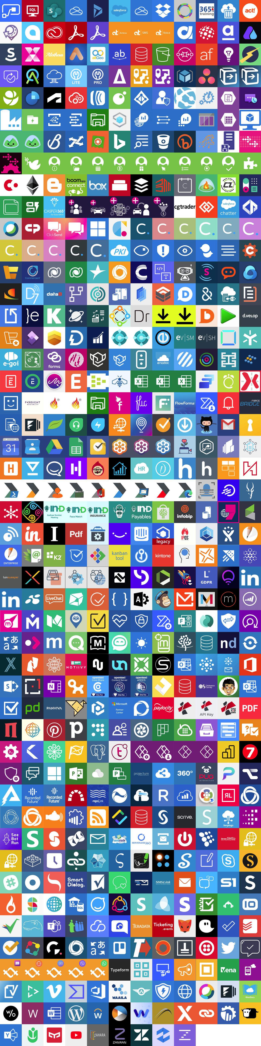
800+ Connectors

Slide 28
Why use custom connectors?
Add services that are not currently supported
Expand connectors that currently don't have the trigger/action you want
Custom connectors are simple to build, don't require a lot of coding
Can be built using the wizard, by importing a postman collection or an OpenAPI v2 definition
Can be shared, packaged and certified via GitHub

Slide 29
Step by step: Build a connector
Read the docs / know the API you want to build the connector for
Start in one of the products (Power Apps, Power Automate or Logic Apps)
Set up the authentication
Define the operations (triggers / actions) for your connector
Add code if needed (for now, C# code is supported)
Save and test your connector

Slide 30






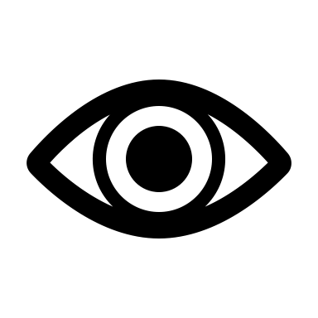







Types of connectors
Connector
Type
Custom Connector
Certified Connector
Independent Publisher Connector
API
Availability
Public or private
Public
Public
Service
Owner
Connector developer or someone else
Connector developer
Someone else
Audience
Internal
Everyone
Everyone

Slide 31
👩🏾‍💻 Lab 3: Create your first Custom Connector

Slide 32
Lab 3 Objectives
Learn how to build a Custom Connector
Learn about best practices for building a Custom Connector
Link to lab: https://aka.ms/mr-workshop-lab3

Slide 33
Lab 3 Presentation
Who would like to show his / her result?

Slide 34
👩🏾‍💻 Lab 4: Use 3D in Canvas Apps

Slide 35
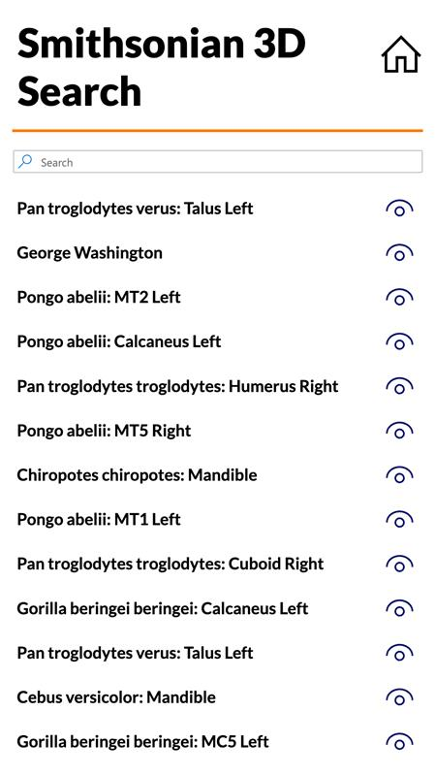
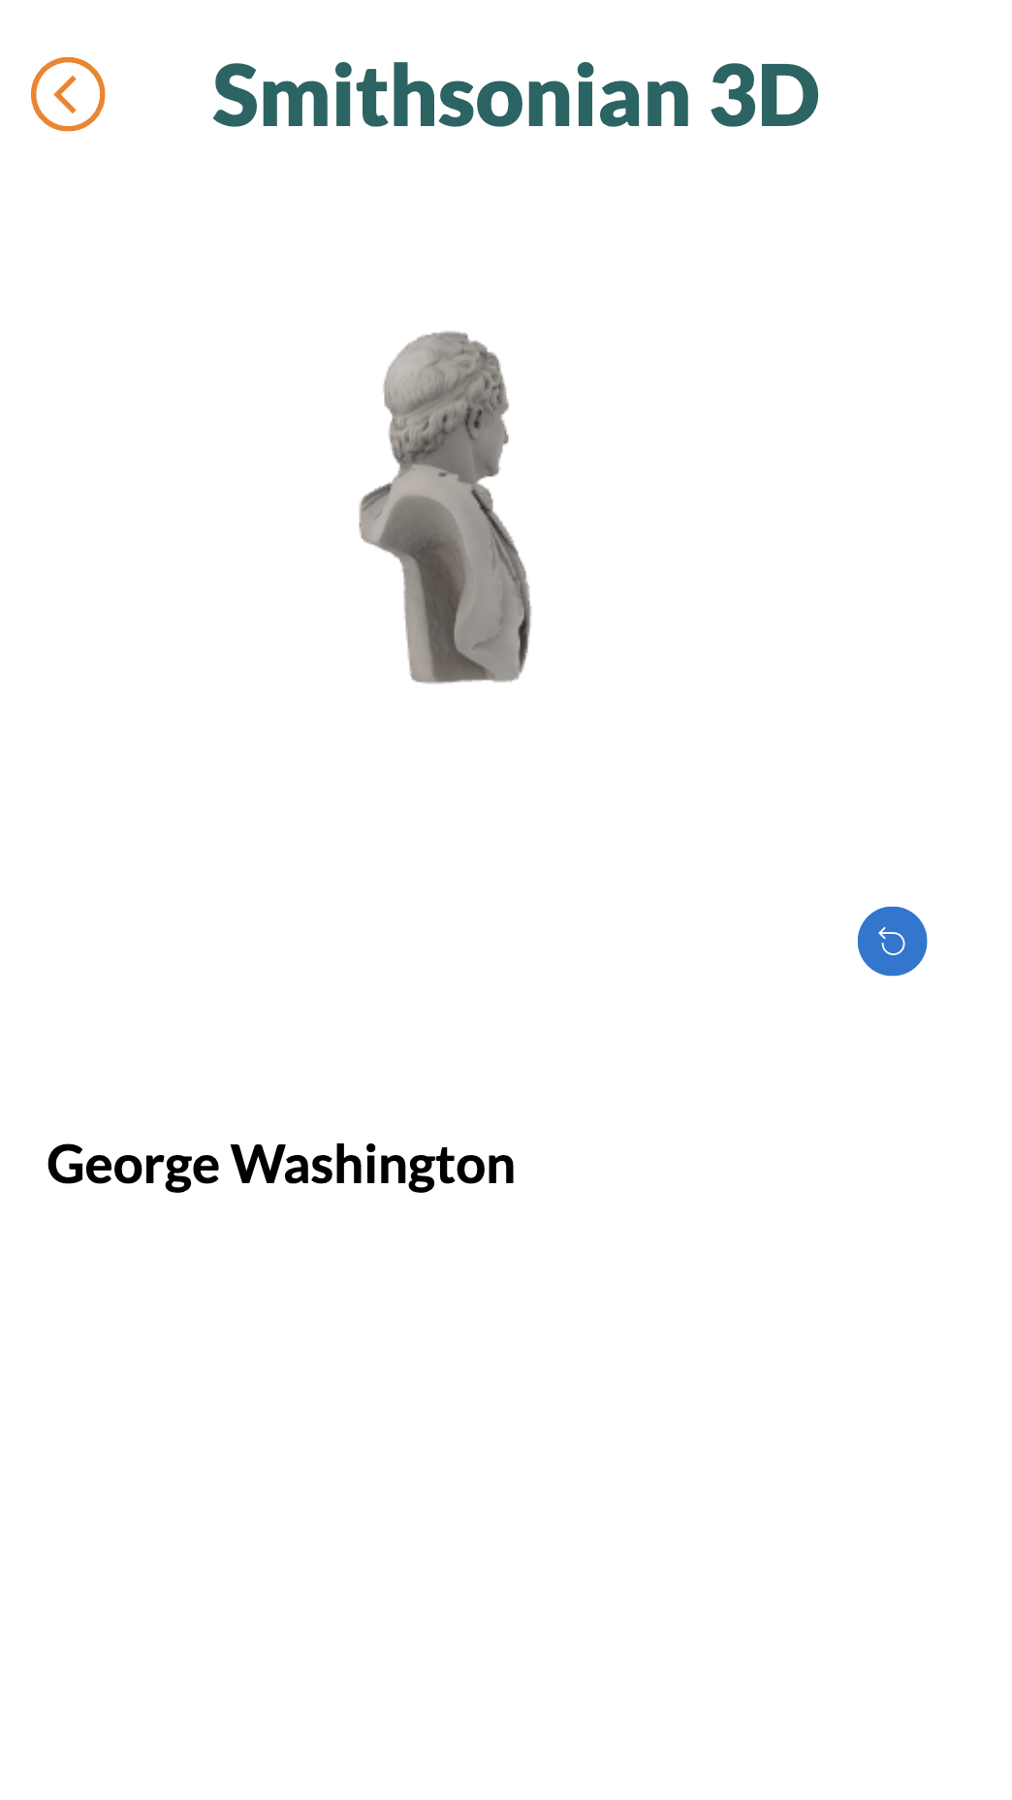
Lab 4 Objectives
Learn how to connect a Custom Connector to a Canvas App
Learn about filtering a data source
Link to lab: https://aka.ms/mr-workshop-lab4

Slide 36
Lab 4 Presentation
Who would like to show his / her result?

Slide 37
Wrap-up and resources

Slide 38
Wrap-up
Thanks for attending
Keep on learning via Microsoft Learn

Slide 39
Resources
Power Platform Resources https://aka.ms/powerplatformresources
Get started with Mixed Reality

Slide 40
Thank you

